Slide 1
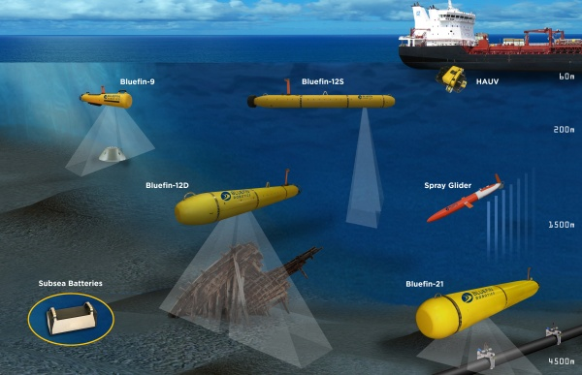
Decentralized Multi-Agent Path Planning
Bobby Holden
Dong Ki Kim
Thomas Leech
Thomas Lone
Navid Shahrestani
Junbin Yuan
Notes:
-Pick up from last time, complex problem to solve
-May include heterogeneous robots that can solve different tasks, scalability, loss of agents, or uncertainty in communication.
-

Slide 2
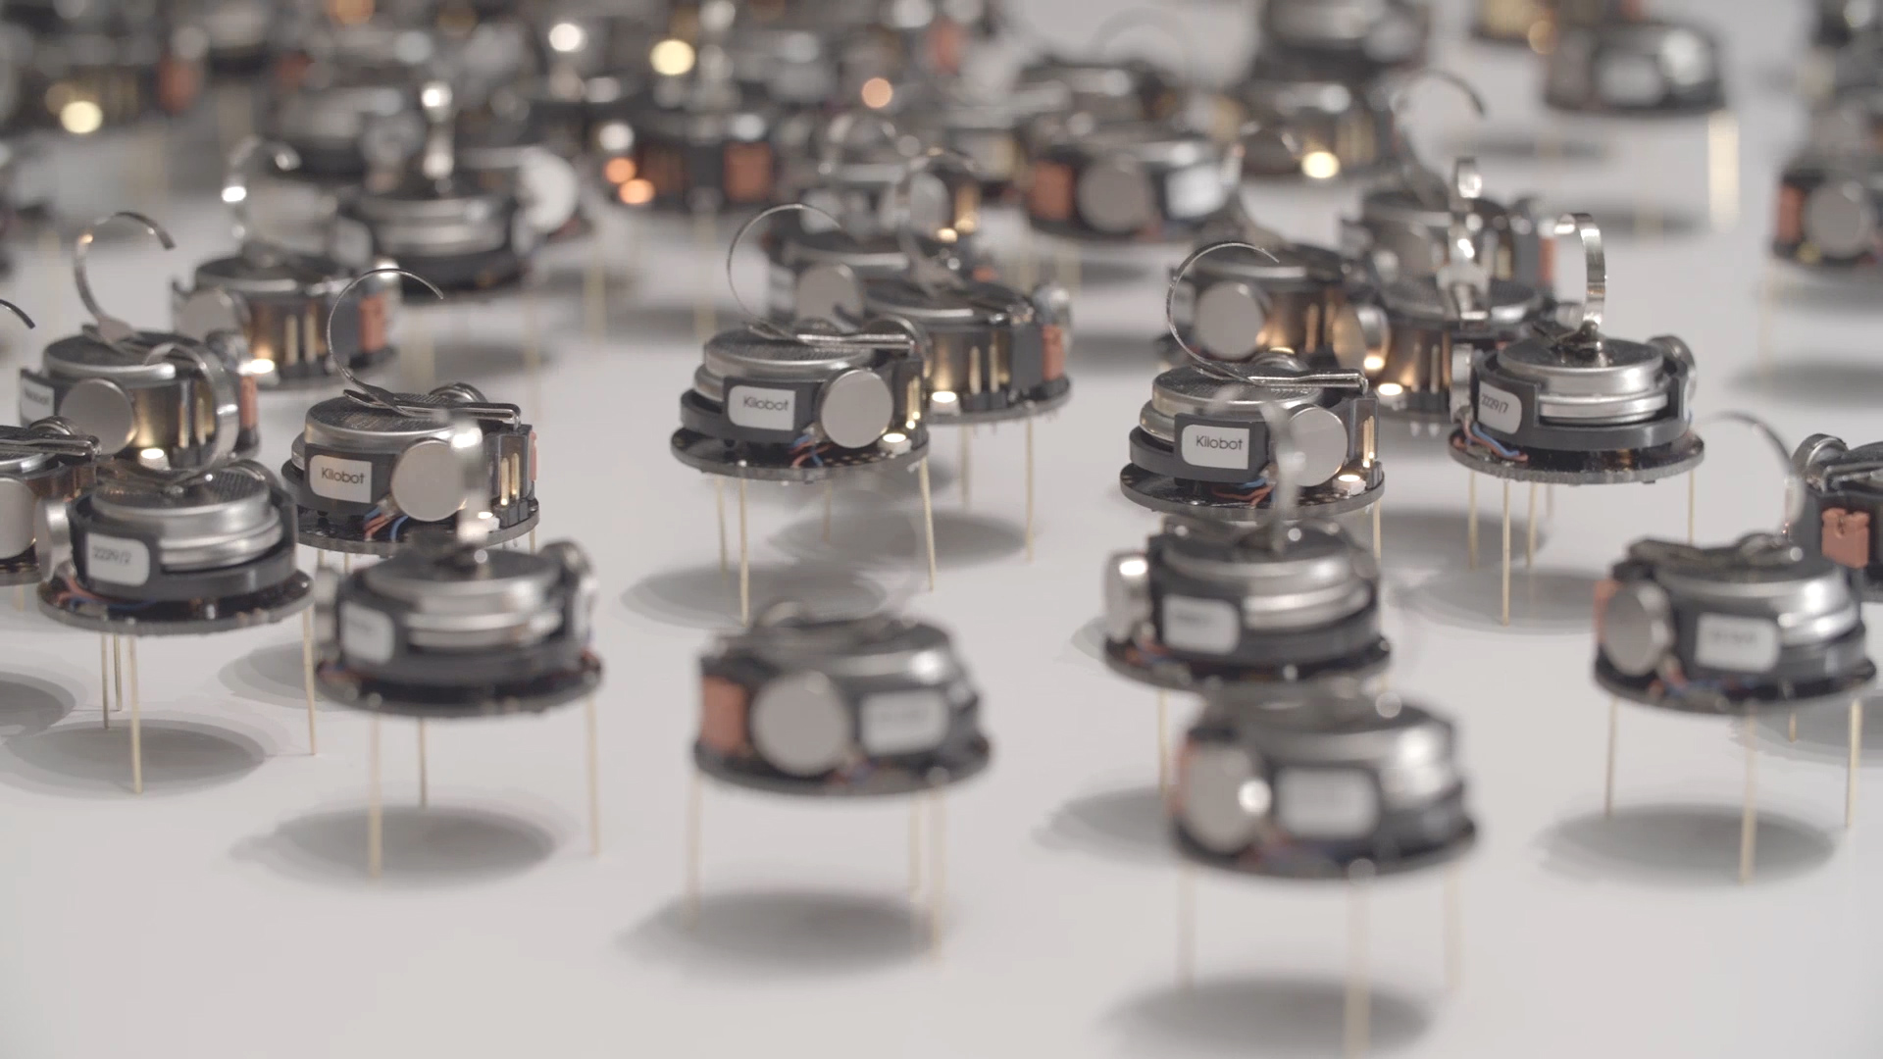
Why use multiple agents?
Increase efficiency
More robust to robot failure
Allows specialized agents
Create a communication network
Enhanced SLAM
A versatile and flexible system

Slide 3
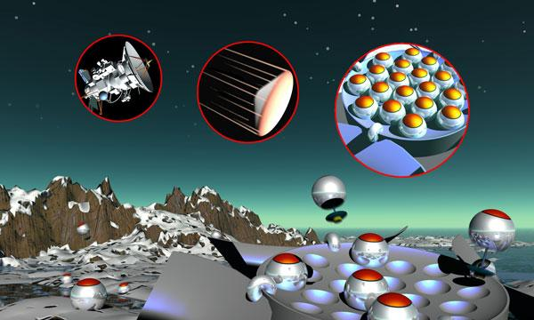
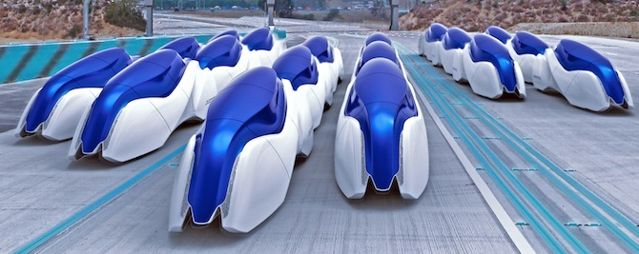
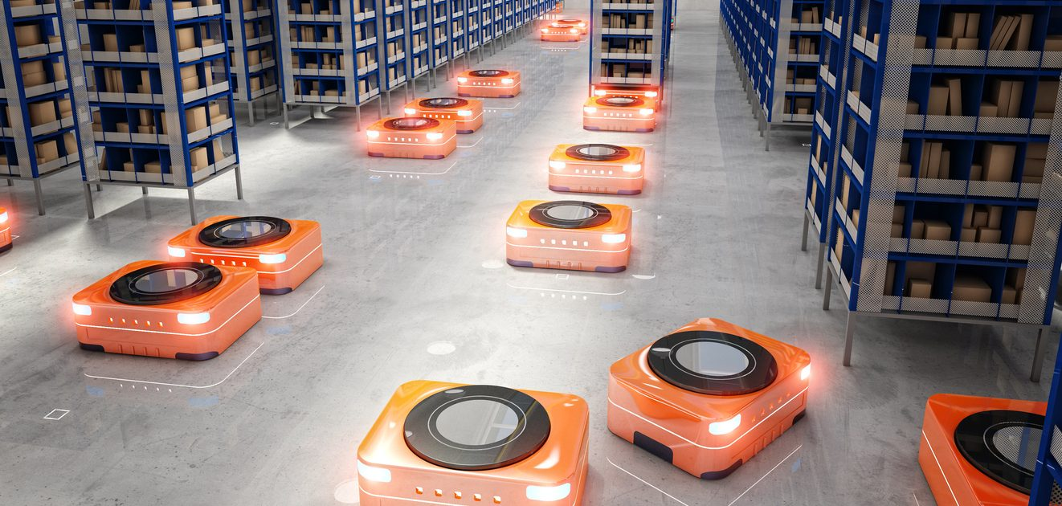
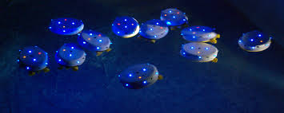
Motivating Applications

Slide 4
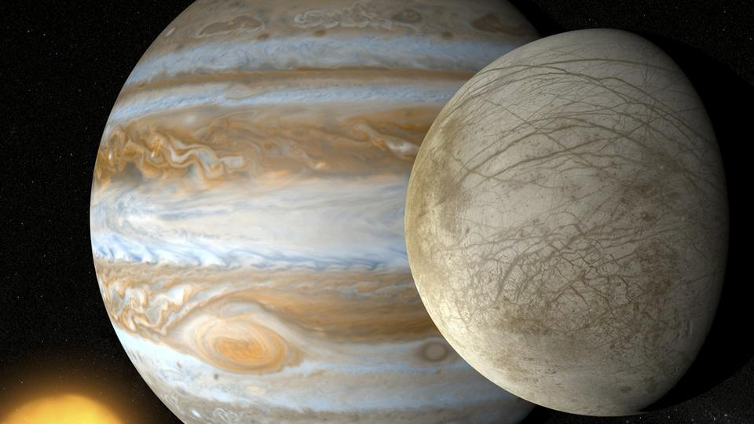
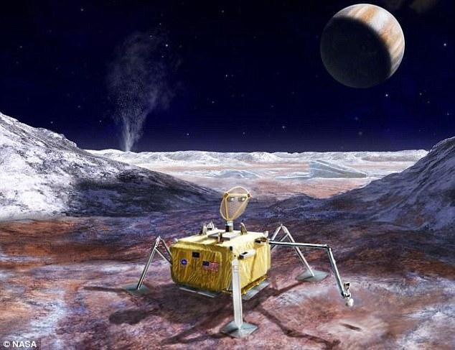

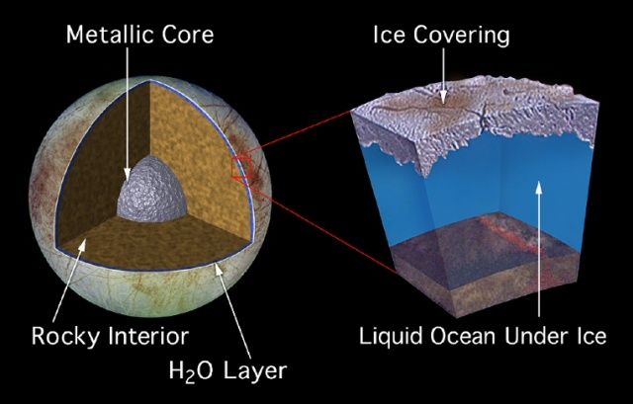
Motivating case: Europa
Notes:
-Active interest for life in solar system
-Deploy huge number of agents to optimize area and efficiently during exploration, to computationally heavy to use centralized algorithm + cannot propagate that much info between agents
-
-

Slide 5

What is decentralized multi-agent path planning?
Path planning without a central controlling unit
Planning happens for each robot, based on information exchange
Solve global problems locally
robust (communication)
Less computations
Local target allocation
Scalability to many agents

Slide 7
Outline
Problem Formulation
Algorithm Pipeline
Target Allocation
Path Generation
Conflict Resolution
Full Implementation
Recent Publications

Slide 8

Problem Formulation
Given: a map of the environment with initial states for agents and targets
N_{a} agents and N_{t} targets
Reach all the targets safely and efficient as possible:
2
?
1
2
1. Allocate targets
2. Path planning
3. Collision avoidance
1

Slide 9
Algorithm Pipeline
Agent i
Waypoints, World Model
Target Allocation
Path Generation
Conflict Resolution
Path Trajectory

Slide 10
Algorithm Pipeline
Agent i
Waypoints, World Model
Target Allocation
Path Generation
Conflict Resolution
Path Trajectory

Slide 11

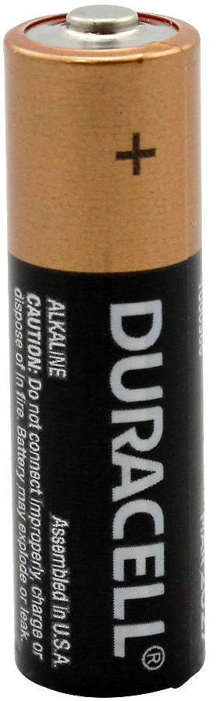
Target allocation
1
2
3
I am close to #1
I can fix #3
which target?

Slide 12
Reward function
1
2
3
19
20
9
2
75
Agent 2
Agent 3
Agent 1

Slide 13
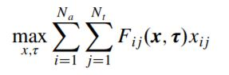
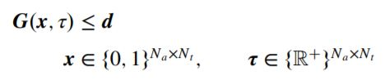
CBBA (consensus-based bundle algorithm )
An auction algorithm
Given: communication and map for some local region
Given N_{a} agents
Given N_{t} targets
Goal: assign agents to targets
Conflict free
Maximizing a global reward function iteratively:
Subject to constraints: (fuel, dynamics, no fly zones)
x=[x_{1,1}, x_{1,2}, x_{2,1}, x_{2,2}]
2
x=[1, 0, 0, 1]
x=[0, 1, 1, 0]
x=[1, 1, 0, 0]
x=[0, 0, 1, 1]
1
Agent 1
Agent 2
Notes:
-Time discounted value of targets
-Dynamics
-Heuristic for path length
-

Slide 14
CBBA: Bids and bundles
1
2
50
60
11
13
Agent 1
Agent 2
b₁=[50,11]
b₂=[13,60]

Slide 15
CBBA: Bids and bundles
A₁=[b₁, b₂]
1
2
A₁=[s₁₁, s₁₂, s₂₁, s₂₂ ]
A₁=[s₁₁, s₁₂, s₂₁, s₂₂ ]
A₁=[s₁₁, s₁₂, s₂₁, s₂₂ ]
A₁=[s₁₁, s₂₂ ]=[50,60]
s₁₁=<1,1,50>
s₂₂=<2,2,60>
s₁₂=<1,2,11>
s₂₁=<2,1,13>
Agent 1
Agent 2
b₁=[50,11]
b₂=[13,60]

Slide 16
CBBA: Definitions
Define a bid as: s_{ij}=<i,j,c_{ij}>
c_{ij}=F_{ij}(x,𝞽)
Define a bundle as vector of bids for a single agent: b_{i}=[s_{ij1}, … , s_{ijN}]
c_{ij}=F_{ij}(b_{i})=F_{ij}(x,𝞽)
Let A be the set of bundles for all the agent globally
Let A_{i} be the local set of bundles that an agent can observe with his communication (A=A_{i} ∀ i ⇒ full global communication)

Slide 17
CBBA: step 1, bundle building
Example: (Consider agent 1)
A₁=[c₁₁=5, c₂₂=10, c₃₃=10]
❌❌
1
2
3
For every agent i:
Remove all i’s assignments from b_{i} and A_{i}
While bundle less than L_{t}:
If: no winning bids:
break (can't win any current targets)
Else:
J*=Target with highest winning bid for i
Append bid for J* to b_{i} and A_{i}
End If
End While
End For
c₁₂=11
c₁₁=2
c₁₃=9
L_{t}=3 b_{i}=[ ]
1: J*=2, b_{i}=[ c₁₂=11]
A₁=[c₁₂=11, c₃₃=10]
2: J*=1, b_{i}=[ c₁₁=2, c₁₂=11]
A₁=[c₁₁=2, c₁₂=11, c₃₃=10]
Notes:
Example on the board!

Slide 18
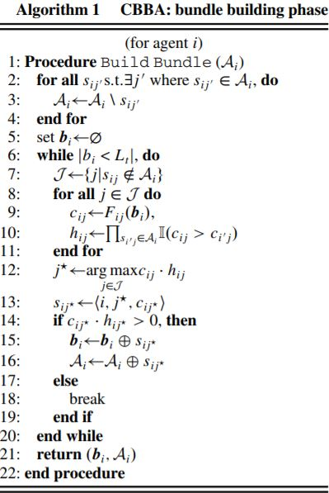
CBBA: step 1, bundle building
For every agent i:
Remove all i’s assignments from b_{i} and A_{i}
While bundle less than L_{t}:
If: no winning bids:
break (can't win any current targets)
Else:
J*=Target with highest winning bid for i
Append bid for J* to b_{i} and A_{i}
End If
End While
End For
Notes:
Example on the board!

Slide 19
CBBA step 2, task consensus
Agents share bid space A_{i}
Losing bids are dropped
If bid space is changing, reenters bundle building
Eventually, few changes are made, the algorithm converges

Slide 20

CBBA step 2, task consensus
A₁=A₂=[s₁₁, s₁₂, s₂₁, s₂₂ ]
A₁=A₂=[s₁₁, s₂₂ ]=[20, 22]
A₁=A₂=[s₁₁, s₁₂, s₂₁, s₂₂ ]
A₁=A₂=[s₁₁, s₁₂, s₂₁, s₂₂ ]
1
2
s₁₁=<1,1,15>
s₁₂=<1,2,10>
b₁=[15,10]
A₁=[s₁₁, s₁₂ ]=[15, 11]
s₁₁=<1,1,20>
s₁₂=<1,2,15>
b₁=[20,15]
A₁=[s₁₁, s₁₂ ]=[20,15]
s₁₁=<1,1,15>
s₁₂=<1,2,10>
b₁=[15,10]
A₁=[s₁₁, s₁₂ ]=[15,10]
s₂₁=<2,1,16>
s₂₂=<2,2,22>
b₂=[16,22]
A₂=[s₂₁, s₂₂ ]=[16,22]
s₂₁=<2,1,11>
s₂₂=<2,2,17>
b₂=[11, 17]
A₂=[s₂₁, s₂₂ ]=[11, 17]
s₂₁=<2,1,11>
s₂₂=<2,2,17>
b₂=[11,17]
A₂=[s₂₁, s₂₂ ]=[11,17]
A₁=[s₁₁, s₂₂ ]=[20, 22]
A₂=[s₁₁, s₂₂ ]=[20, 22]
Agent 1
Agent 1
Agent 2
Agent 2

Slide 21
Algorithm Pipeline
Agent i
Waypoints, World Model
Target Allocation
Path Generation
Conflict Resolution
Path Trajectory

Slide 22
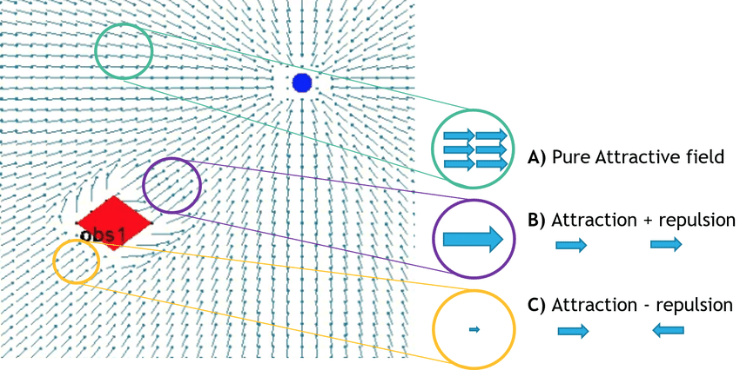
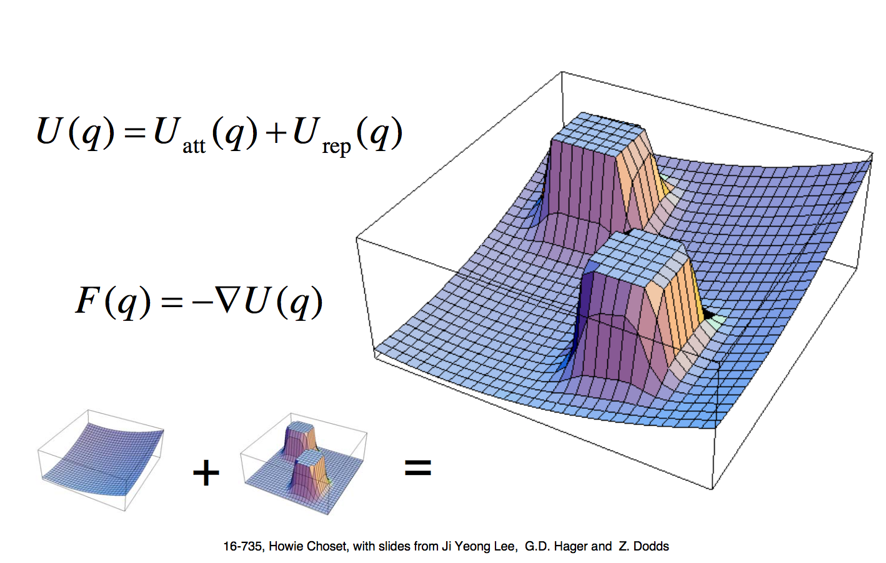
Path planning approaches
Artificial Potential Fields (APF)
Pros : Computationally cheap
Cons : Can get trapped in local minima

Slide 23
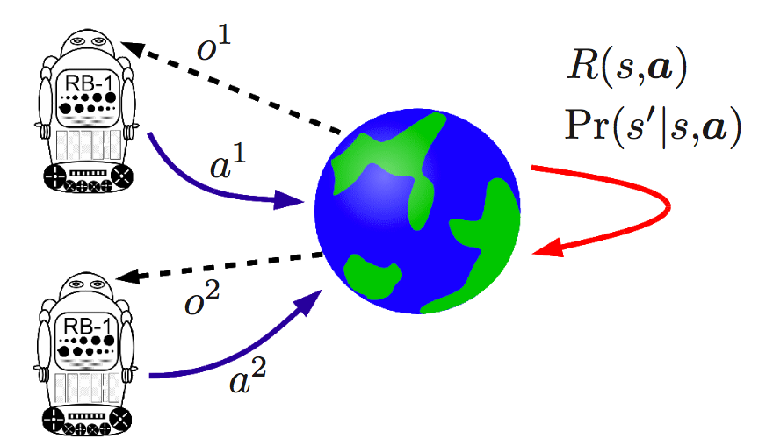
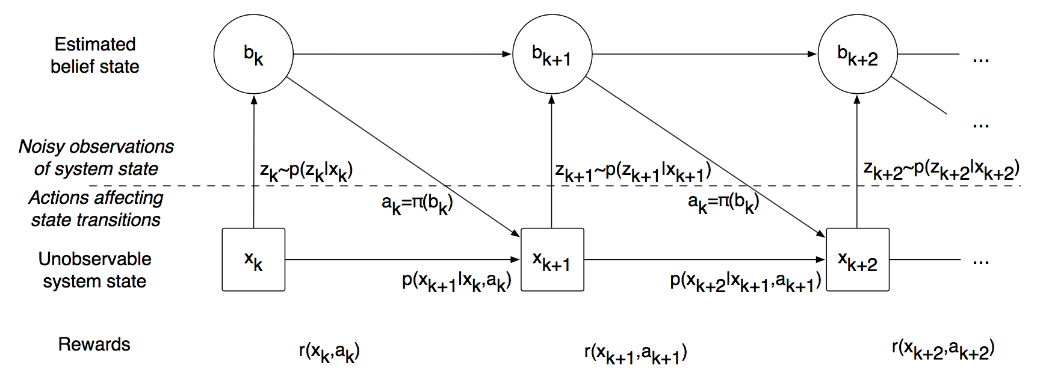
Path planning approaches
Artificial Potential Fields (APF)
Reward-based (e.g. Dec-POMDPs)
Pros : Generates optimal paths
Cons : NEXP-complete

Slide 24
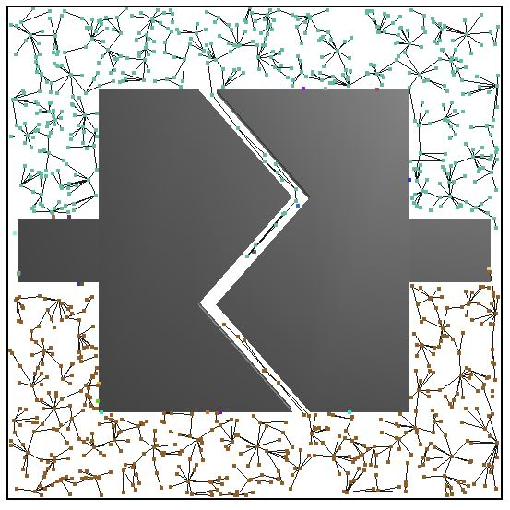
Path planning approaches
Artificial Potential Fields (APF)
Reward-based (e.g. Dec-POMDPs)
Sample-based (e.g. RRT, PRM)
Pros : Handles highly dimensional spaces
Cons : Probabilistically complete

Slide 25
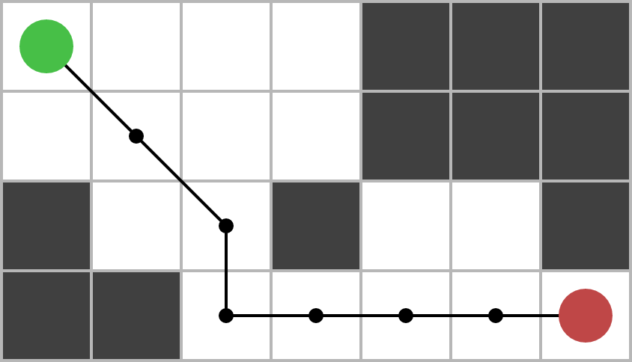
Path planning approaches
Artificial Potential Fields (APF)
Reward-based (e.g. Dec-POMDPs)
Sample-based (e.g. RRT, PRM)
Grid-based (e.g. A*, D*)
Pros : Complete
Cons : Limited by grid resolution
Grid-based planners are generally less efficient than sample-based planners, however provide stronger guarantees

Slide 26
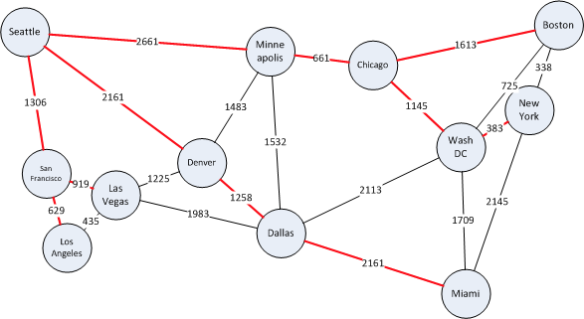
Brief (and not complete) history of grid-based path planners
Dijkstras Algorithm (Edsger Dijkstra; 1956)

Slide 27
Brief (and not complete) history of grid-based path planners
Dijkstras Algorithm (Edsger Dijkstra; 1956)
A* (Nils Nilsson, Peter Hart, Bertram Raphael; 1968)
Adds heuristic to guide search from start node

Slide 28
Brief (and not complete) history of grid-based path planners
Dijkstras Algorithm (Edsger Dijkstra; 1956)
A* (Nils Nilsson, Peter Hart, Bertram Raphael; 1968)
Adds heuristic to guide search from start node
D* (Anthony Stentz; 1994)
Dynamic A*, re-evaluates nodes as edge costs change

Slide 29
Brief (and not complete) history of grid-based path planners
Dijkstras Algorithm (Edsger Dijkstra; 1956)
A* (Nils Nilsson, Peter Hart, Bertram Raphael; 1968)
Adds heuristic to guide search from start node
D* (Anthony Stentz; 1994)
Dynamic A*, re-evaluates nodes as edge costs change
LPA* (Sven Koenig; 2004)
Incremental A*
D* Lite (Sven Koenig, Max Likhachev; 2005)
Reversal of LPA*, determines shortest path between current node and goal node

Slide 30
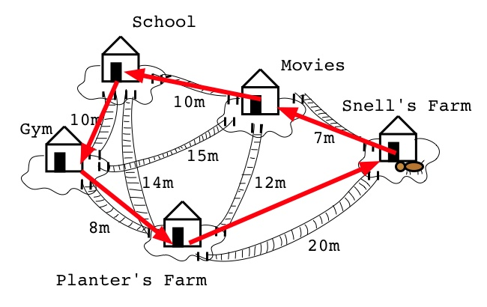
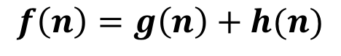
A* Refresher
Open list : Nodes to be examined
Closed list : Nodes already explored
Nodes ordered in open list by evaluation function
Move top node from open list to closed list and add its neighbors to the open list
Path found when goal node is in the open list

Slide 31
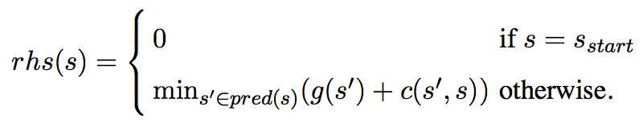
How do we handle changes in environment?
Lifelong Planning A* (LPA*) introduces right hand side (rhs) value
Compares rhs(s) to g(s), inconsistent nodes are added to priority list
rhs(s) == g(s) (locally consistent)
rhs(s) > g(s) (under-consistent)
rhs(s) < g(s) (over-consistent)
s′
c(s′,s)
s
Key value used to sort the priority list

Slide 32
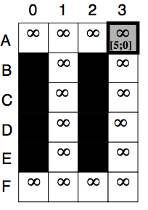
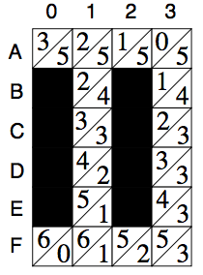
LPA* Example
Iteration #1
Start
g(s)
h(s)
Goal

Slide 33
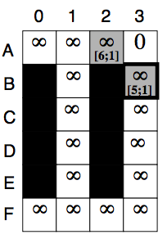
LPA* Example
Iteration #2
Start
g(s)
h(s)
Goal

Slide 34
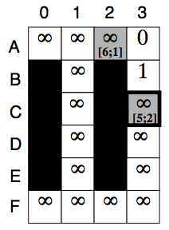
LPA* Example
Iteration #3
Start
g(s)
h(s)
Goal

Slide 35
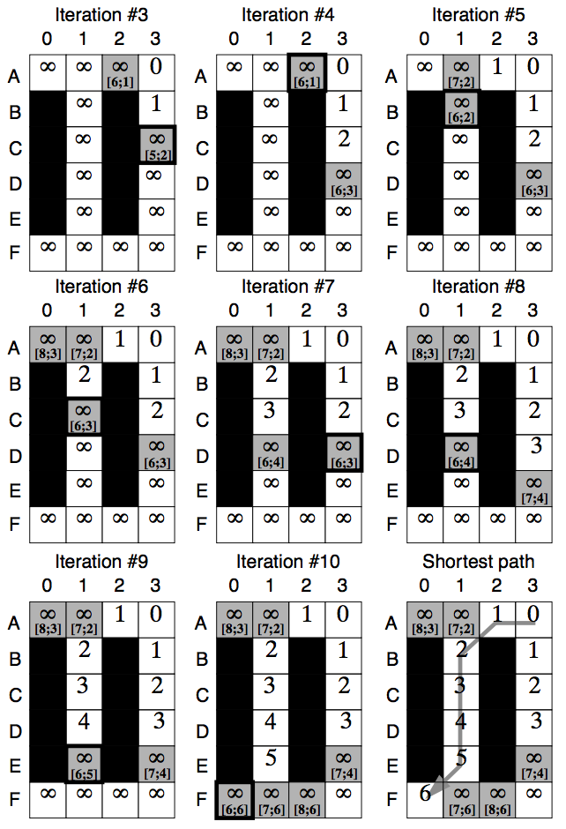
LPA* Example

Slide 36
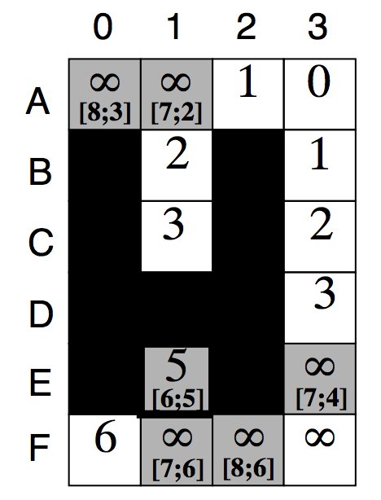
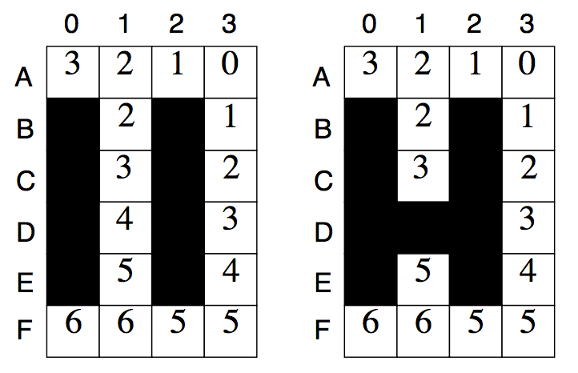
LPA* Replanning
Environment has changed!

Slide 37
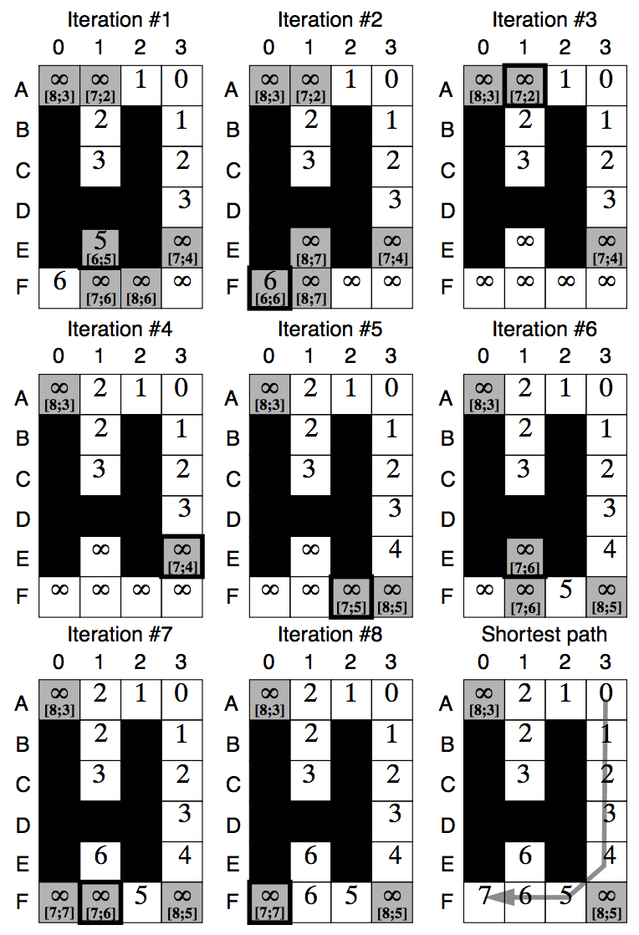
LPA* Replanning

Slide 38

Issues with LPA* replanning?
Does not take into account robot motion
Why re-calculate paths if we’ve already moved passed that region?
D*lite addresses this!
Derived from LPA*, however reverses search (finds shortest path from goal node to start node)
changes as we move towards goal

Slide 39
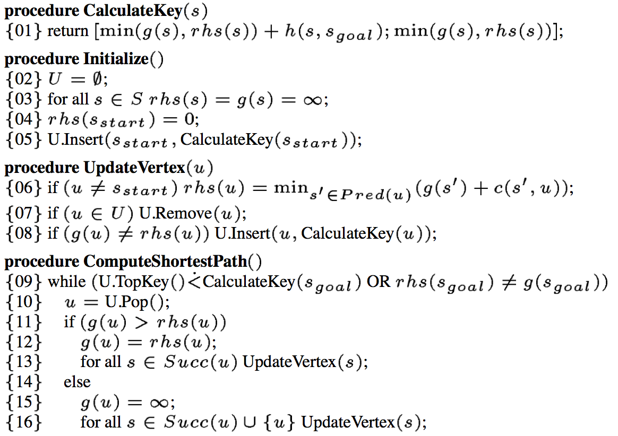
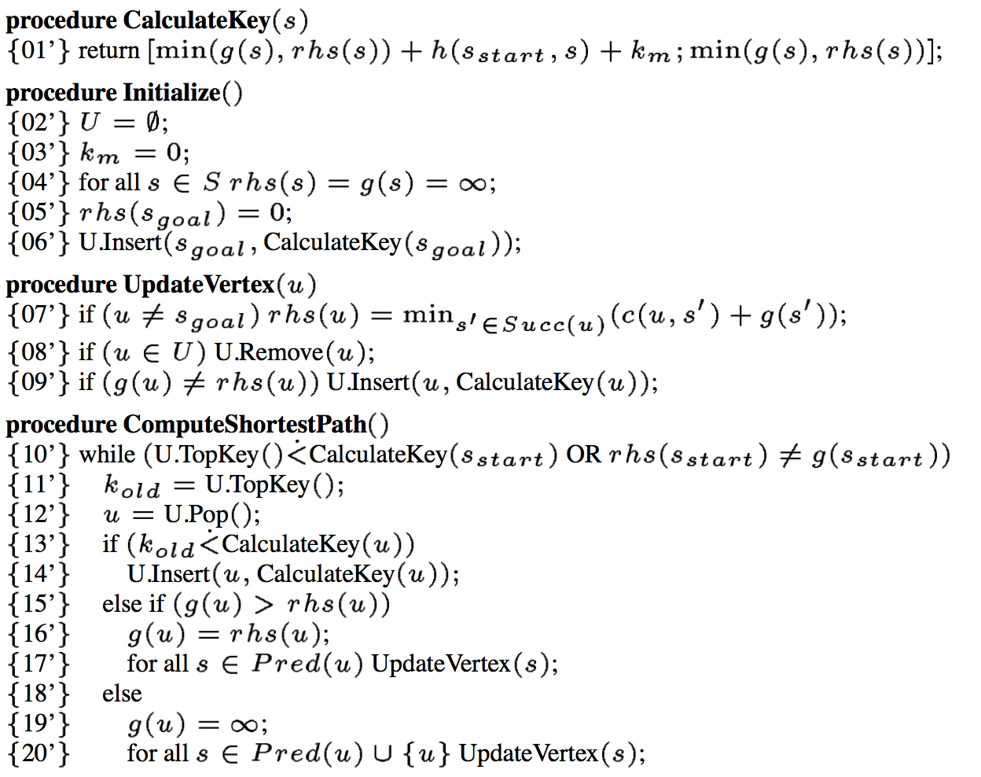
LPA* vs. D*Lite
LPA*
D*Lite

Slide 40
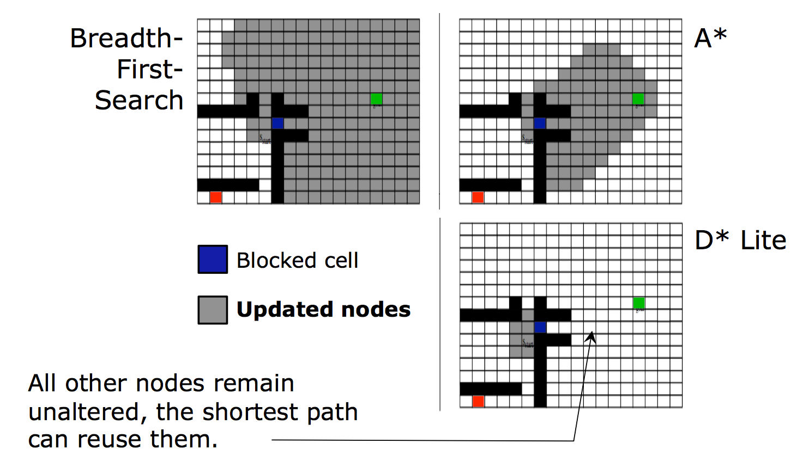
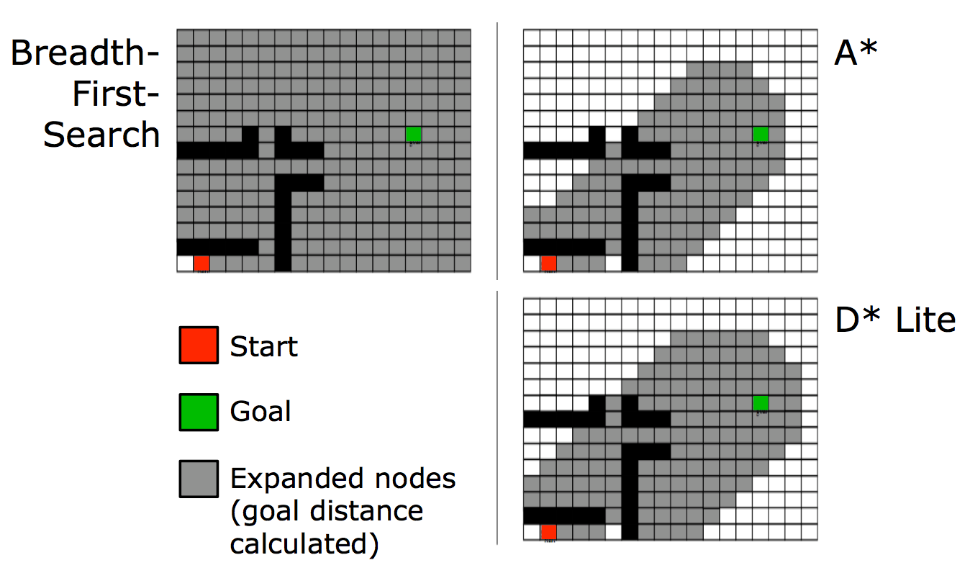
Comparing performance

Slide 41
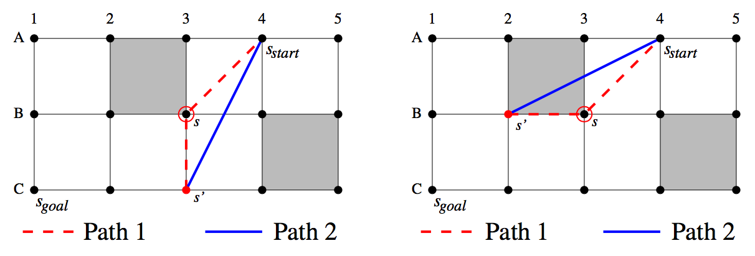
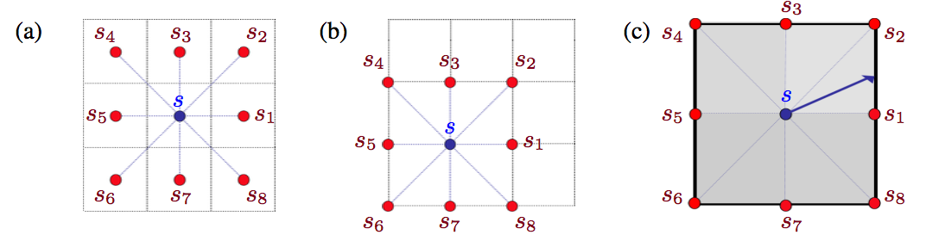
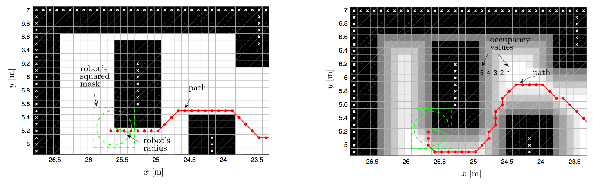
Grid-based search limitations?
Paths are limited by small, discrete set of possible transitions between grid cells
Field D*
Theta*
Limited to binary occupancy grids
Two-way D* (TWD*)

Slide 42
What about the multi-agent case?
How do we avoid collisions?

Slide 43
Algorithm Pipeline
Agent i
Waypoints, World Model
Target Allocation
Path Generation
Conflict Resolution
Path Trajectory

Slide 44
Conflict Example
A1
4
3
2
1
2
A2
1
1 2 3 4

Slide 45
Conflict Example
A1
4
3
2
1
2
A2
1
1 2 3 4

Slide 46
Conflict Example
A1
4
3
2
1
2
A2
1
1 2 3 4

Slide 47
Inter-robot communication
Path
Paths
v-profiles & cost
v-profiles & costs
Yes
Path Generation
Form Coordination Diagram
Find conflict-free velocity profile
Path Generation
Conflicts?
Choose best v-profile
Conflicts?
No
v-profiles & path
Controller

Slide 48
Resolving Conflict
A1
4
3
2
1
2
A2
1
1 2 3 4

Slide 49
Resolving Conflict
A1
4
3
2
1
2
A2
1
1 2 3 4

Slide 50
Resolving Conflict
4
3
2
1
2
A1
A2
1
1 2 3 4

Slide 51
Resolving Conflict
4
3
2
1
2
A1
A2
DELAY
1
1 2 3 4

Slide 52
Resolving Conflict
4
3
2
1
2
A2
A1
DELAY
1
1 2 3 4

Slide 53
Resolving Conflict
4
3
2
1
2
A2
A1
1
1 2 3 4

Slide 54
Resolving Conflict
4
3
2
1
2
A2
A1
1
1 2 3 4

Slide 55

Resolving Conflict
4
3
2
1
2
A2
?
?
?
1
1 2 3 4

Slide 56
Resolving Conflict
A2
4
3
2
1
2
1 2 3 4

Slide 57
Inter-robot communication
Path
Paths
v-profiles & cost
v-profiles & costs
Yes
Form Coordination Diagram
Path Generation
Conflicts?
Form Coordination Diagram
Find conflict-free velocity profile
Choose best v-profile
Conflicts?
No
v-profiles & path
Controller

Slide 58
Coordination Diagram
A1
4
3
2
1
2
A2
1
1 2 3 4

Slide 59
Coordination Diagram
A1
4
3
2
1
2
P1: (1,4)->(2,4)->(2,3)->(3,3)->(3,2)->(4,2)->(4,1)
A2
1
1 2 3 4

Slide 60
Coordination Diagram
A1
4
3
2
1
2
P1: (1,4)->(2,4)->(2,3)->(3,3)->(3,2)->(4,2)->(4,1)
P2: (1,1)->(2,1)->(2,2)->(3,2)->(3,3)->(4,3)->(4,4)
A2
1
1 2 3 4

Slide 61
(1,4) (2,4) (2,3) (3,3) (3,2) (4,2) (4,1)
Agent 1’s Path

Slide 62
(4,4)
(4,3)
(3,3)
(3,2)
(2,2)
(2,1)
(1,1)
Agent 2’s Path
(1,4) (2,4) (2,3) (3,3) (3,2) (4,2) (4,1)
Agent 1’s Path

Slide 63
(4,4)
(4,3)
(3,3)
(3,2)
(2,2)
(2,1)
(1,1)
Agent 2’s Path
(1,4) (2,4) (2,3) (3,3) (3,2) (4,2) (4,1)
Agent 1’s Path

Slide 64
(4,4)
(4,3)
(3,3)
(3,2)
(2,2)
(2,1)
(1,1)
Agent 2’s Path
(1,4) (2,4) (2,3) (3,3) (3,2) (4,2) (4,1)
Agent 1’s Path

Slide 65
(4,4)
(4,3)
(3,3)
(3,2)
(2,2)
(2,1)
(1,1)
Agent 2’s Path
(1,4) (2,4) (2,3) (3,3) (3,2) (4,2) (4,1)
Agent 1’s Path

Slide 66
(4,4)
(4,3)
(3,3)
(3,2)
(2,2)
(2,1)
(1,1)
Agent 2’s Path
(1,4) (2,4) (2,3) (3,3) (3,2) (4,2) (4,1)
Agent 1’s Path

Slide 67
Inter-robot communication
Path
Paths
v-profiles & cost
v-profiles & costs
Yes
Form Coordination Diagram
Form Coordination Diagram
Find conflict-free velocity profile
Path Generation
Conflicts?
Find conflict-free velocity profile
Choose best v-profile
Conflicts?
No
v-profiles & path
Controller

Slide 68
(4,4)
(4,3)
(3,3)
(3,2)
(2,2)
(2,1)
(1,1)
Agent 2’s Path
(1,4) (2,4) (2,3) (3,3) (3,2) (4,2) (4,1)
Agent 1’s Path

Slide 69
(4,4)
(4,3)
(3,3)
(3,2)
(2,2)
(2,1)
(1,1)
Agent 2’s Path
(1,4) (2,4) (2,3) (3,3) (3,2) (4,2) (4,1)
Agent 1’s Path

Slide 70
(4,4)
(4,3)
(3,3)
(3,2)
(2,2)
(2,1)
(1,1)
Agent 2’s Path
(1,4) (2,4) (2,3) (3,3) (3,2) (4,2) (4,1)
Agent 1’s Path

Slide 71
Inter-robot communication
Path
Paths
v-profiles & cost
v-profiles & costs
Yes
Form Coordination Diagram
Find conflict-free velocity profile
Path Generation
Find conflict-free velocity profile
Choose best v-profile
Conflicts?
Choose best v-profile
Conflicts?
No
v-profiles & path
Controller

Slide 72
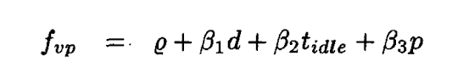
Cost function
ϱ: cost for hitting obstacle
d: cost for distance
t: cost for idle robots
p: cost for robot priority

Slide 73
Problems
Slow performance
Guo and Parker took minutes to search Coordination Diagram
A lot of information sharing
Limited communications in some environments
Security issues
Intolerant to noisy communication

Slide 74
What if we didn’t need everyone’s path?

Slide 75
Velocity Obstacles
A2
A1

Slide 76
Velocity Obstacles
A2
A1

Slide 77
Velocity Obstacles
A2
A1

Slide 78
Velocity Obstacles
A2
A1

Slide 79
Velocity Obstacles
A2
A1

Slide 80
Velocity Obstacles
A2
A1

Slide 81
Velocity Obstacles
A2
V2
A1

Slide 82
Velocity Obstacles
A2
V2
A1
V2

Slide 83
Velocity Obstacles
A2
V2
A1
V2

Slide 84
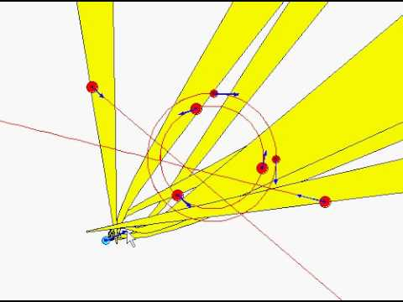

Slide 85
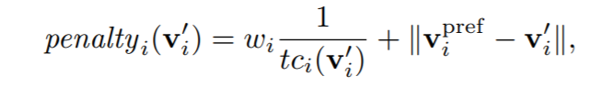
How do we select velocities?
For each agent:
Find velocity object for all other agents
Constrain velocity choices based on dynamics model
Find a preferred velocity
Choose the velocity closest to preferred velocity

Slide 86
Velocity Obstacles
Pros
We don’t need everyone’s path
Cut back on communication
Cons
Can lead to oscillations

Slide 87
A2
1
A1
2

Slide 88
A2
1
A1
2

Slide 89
1
A2
A1
2

Slide 90
1
A2
A1
2

Slide 91
1
A2
A1
2

Slide 92
1
A2
A1
2

Slide 93
1
A2
A1
2

Slide 94
1
A2
A1
2

Slide 95
1
A2
A1
2

Slide 96
1
A2
A1
2

Slide 97
1
A2
A1
2

Slide 98
Reciprocal Velocity Obstacles
A2
V2
V1
A1
V2

Slide 99
Reciprocal Velocity Obstacles
A2
V2
V1
A1
(V1+V2)/2
V2

Slide 100
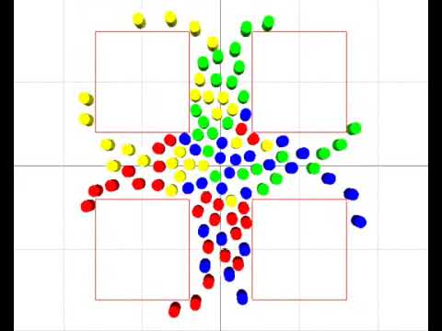
RVO in action!
Source: Jur van den Berg, Ming C. Lin, Dinesh Manocha "Reciprocal Velocity Obstacles for Real-Time Multi-Agent Navigation" Proceedings of the IEEE International Conference on Robotics and Automation (ICRA), 2008.

Slide 101
Outline
Problem Formulation
Algorithm Pipeline
Target Allocation
Path Generation
Conflict Resolution
Full Implementation
Recent Publications

Slide 102
Algorithm Pipeline
Agent i
Waypoints, World Model
Target Allocation
Path Generation
Conflict Resolution
Path Trajectory

Slide 103
Algorithm Pipeline
Agent i
Waypoints, World Model
Target Allocation
Algorithm : CBBA
Run when : Target list updated or number of agents changes
Path Generation
Conflict Resolution
Path Trajectory

Slide 104
Algorithm Pipeline
Agent i
Waypoints, World Model
Target Allocation
Algorithm : CBBA
Run when : Target list updated or number of agents changes
Path Generation
Algorithm : D*lite
Run when : Edge costs change
Conflict Resolution
Path Trajectory

Slide 105
Approach 1
Agent i
Waypoints, World Model
Target Allocation
Algorithm : CBBA
Run when : Target list updated or number of agents changes
Path Generation
Algorithm : D*lite
Run when : Edge costs change
Conflict Resolution
Algorithm : Coordination
diagrams
Run when : New path generated
Path Trajectory

Slide 106
Approach 2
Agent i
Waypoints, World Model
Target Allocation
Algorithm : CBBA
Run when : Target list updated or number of agents changes
Path Generation & Conflict Resolution
Algorithm : RVO
Run when : As close to real-time as possible
Path Trajectory

Slide 107
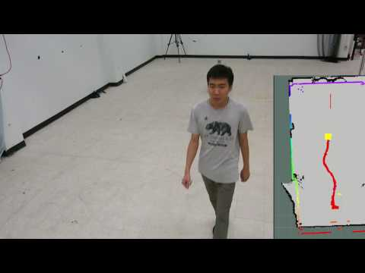
Decentralized Multi-Agent Collision Avoidance using Deep Learning
(using agent joint configuration)

Slide 108
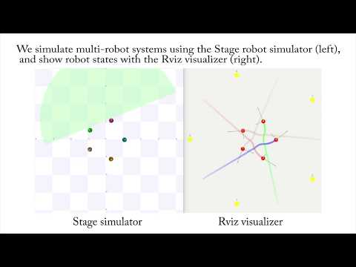
Decentralized Multi-Agent Collision Avoidance using Deep Learning
(using raw sensor measurements)

Slide 109


Slide 110
Appendix / Backup slides

Slide 111
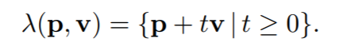
Velocity Object Definition
Minkowski Sum:
Velocity Object:

